Slide 1

Global Cyber Security Threats

Slide 2
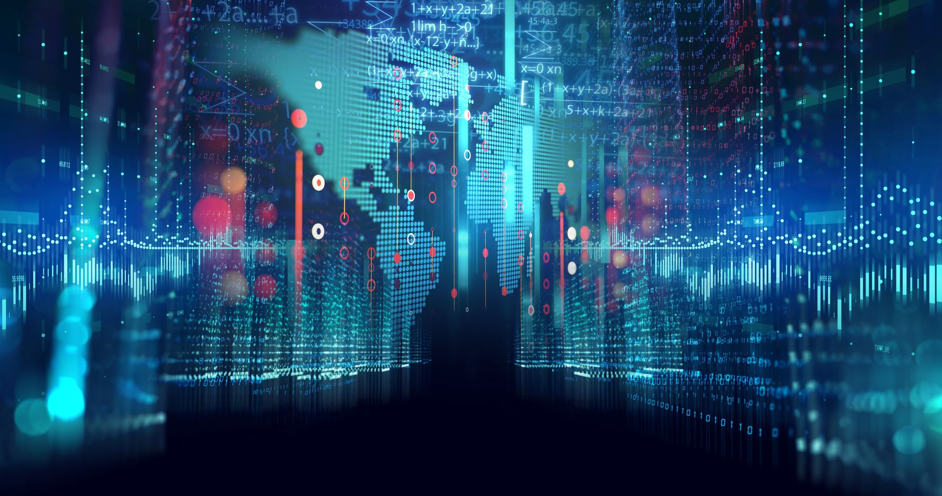
Introduction
In today’s digital-first world, cybersecurity has become a top priority for organizations and nations alike. With the growing reliance on digital infrastructure, cyber threats have evolved in scale, complexity, and frequency.
This project explores global cybersecurity trends using Tableau, transforming raw data into clear, interactive visual stories.
Through this analysis, we aim to uncover regional vulnerabilities, identify the most common types of cyberattacks, and observe threat patterns over time.
By visualizing these patterns, decision-makers and cybersecurity professionals can proactively respond to risks, improve defenses, and better prepare for emerging threats.

Slide 3
Global Cybersecurity Threats Dataset — Description
The Global Cybersecurity Threats dataset captures reported cyber incidents worldwide, offering a comprehensive view of the evolving digital threat landscape. It consolidates data from various sources, including cybersecurity monitoring tools, threat intelligence reports, and international cybersecurity organizations.
Country: The country where the incident took place or was reported.
Year: The year when the cyber threat incident was recorded.
Attack Type: The category of cyberattack (e.g., Malware, Phishing, DDoS).
Target Industry: The industry or sector targeted by the cyber threat (e.g., Finance, Healthcare, Government).
Financial Loss (in Million $): Estimated financial loss caused by the cyber incident, in millions of US dollars.
Number of Affected Users: Number of users or accounts impacted by the incident.
Attack Source: The origin of the attack (e.g., External Threat Actor, Insider Threat, Nation-State).
Security Vulnerability Type: The specific vulnerability exploited during the attack (e.g., Software Flaw, Weak Passwords, Unpatched Systems).
Defense Mechanism Used: The defensive measures that were employed to respond to or prevent the attack (e.g., Firewalls, Encryption, Intrusion Detection Systems).
Incident Resolution Time (in Hours): Time taken to resolve or mitigate the incident, measured in hours.

Slide 4
Data Cleaning and Problem Statement
Data Cleaning Data Interpreter is Tableau’s built-in tool that helps clean messy data — it can recognize titles, subtitles, extra rows, or merged cells and automatically clean up the structure when importing data.
Problem Statement: How the rapid increase in global cybersecurity threats has exposed critical vulnerabilities across industries?Does this growing wave of cyberattacks causes severe financial and reputational damage and what are the significant risks to national security, data privacy, and public trust worldwide

Slide 5
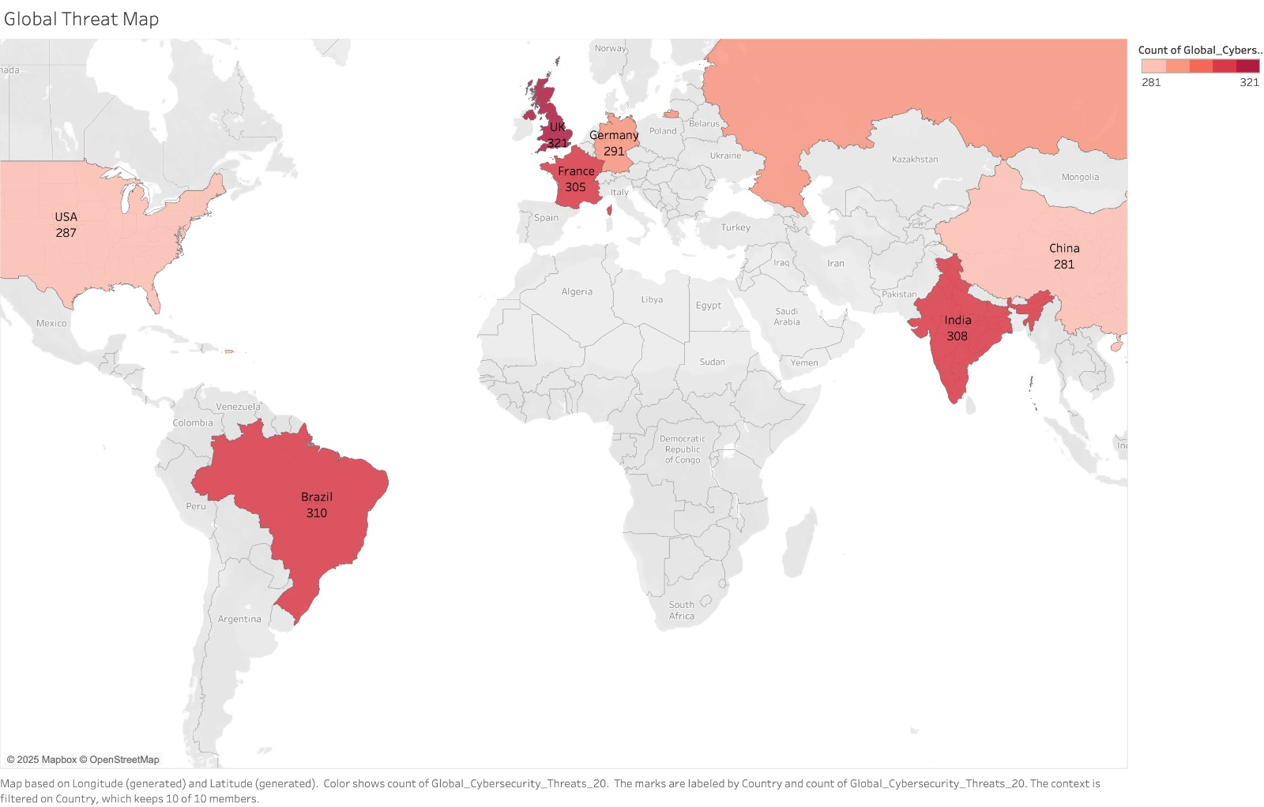
Key Insights and Findings
UK records the highest number of cybersecurity incidents globally (2015–2024).
Cyber threats are widely distributed but heavily concentrated in Europe, North America, and Asia-Pacific.
Emerging risk zones include parts of Africa and South America, showing increasing incident trends.

Slide 6
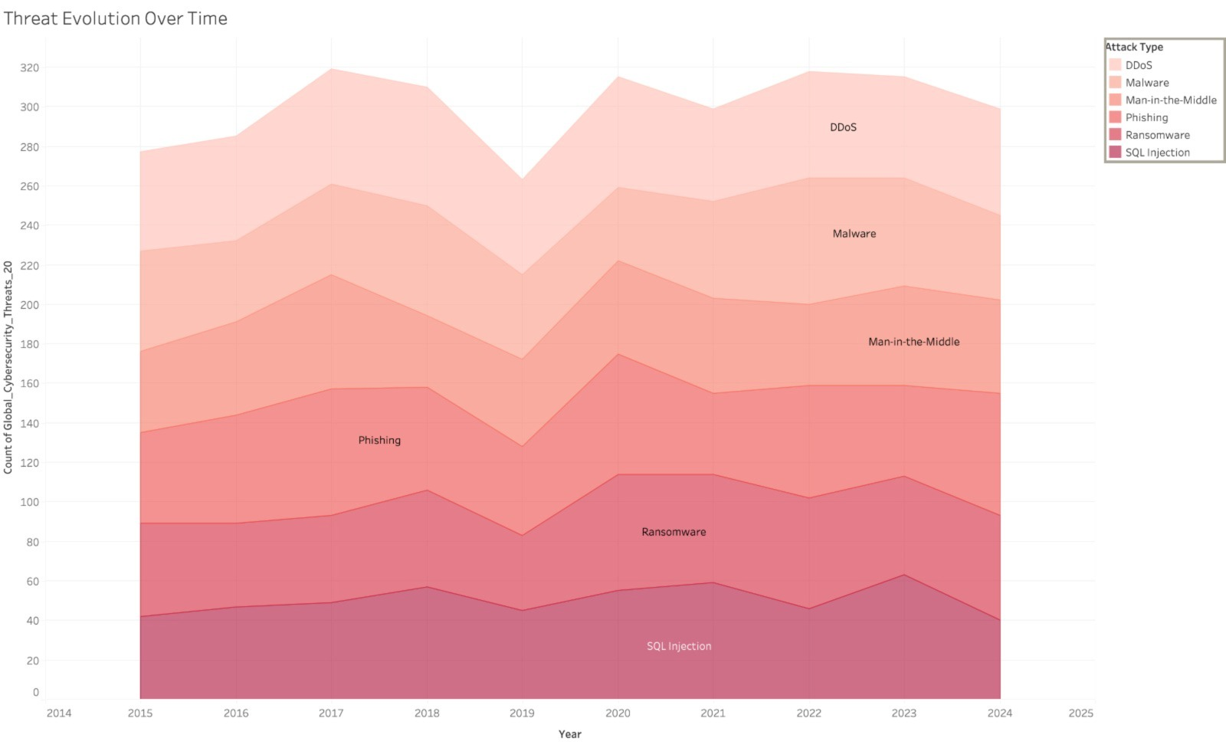
Threat Category Breakdown
Malware and Phishing dominate the threat landscape globally.
Rising trend in Ransomware attacks, especially post-2020.
Data breaches remain a persistent issue across all sectors.

Slide 7
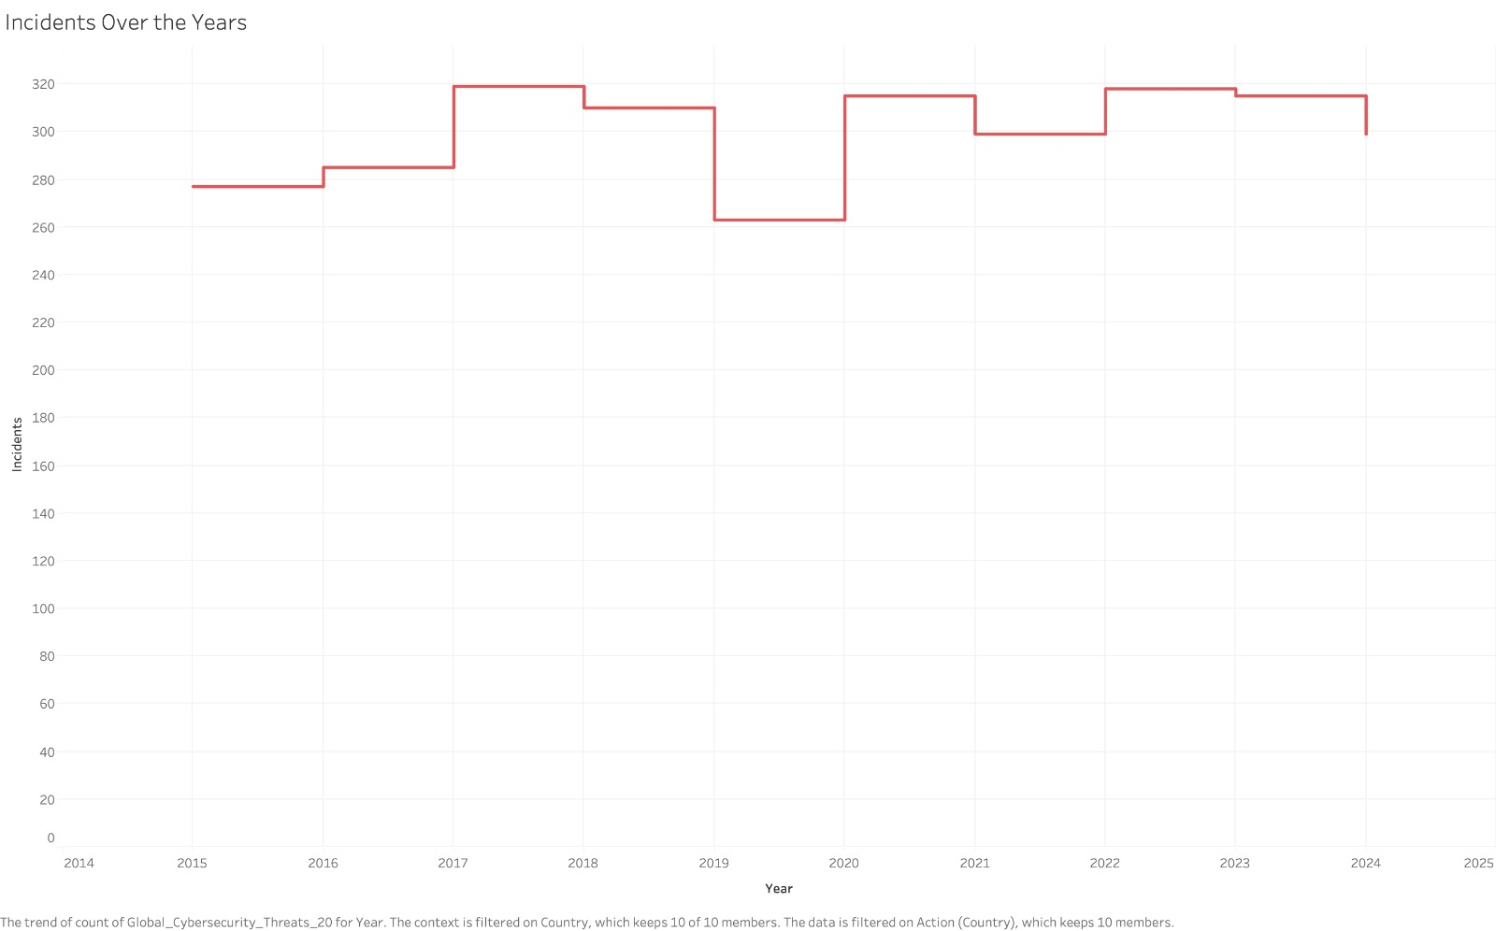
Yearly Trends (2015-2024)
Steady rise in reported incidents year over year.
Significant spike observed around 2020–2021, correlating with the increase in remote work and digital transformation during the pandemic.
Post-pandemic, the threat landscape has evolved with more sophisticated attacks.

Slide 8
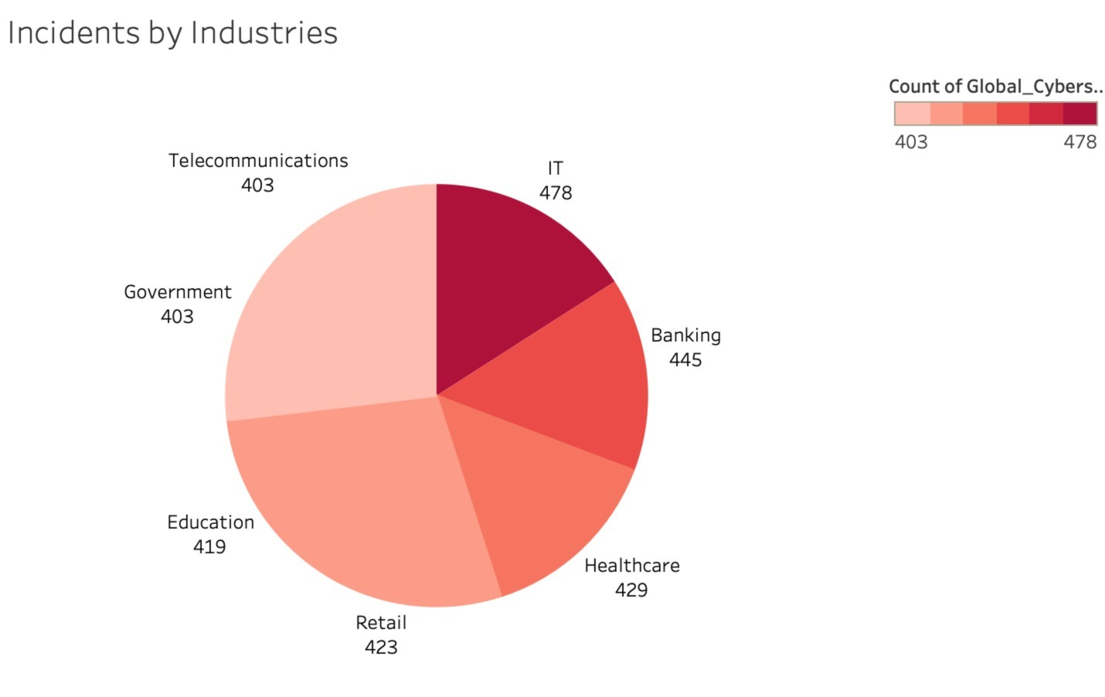
Industry Targeting
Financial services, healthcare, and government sectors are the most targeted industries.
Education and manufacturing sectors also show increasing vulnerability.

Slide 9
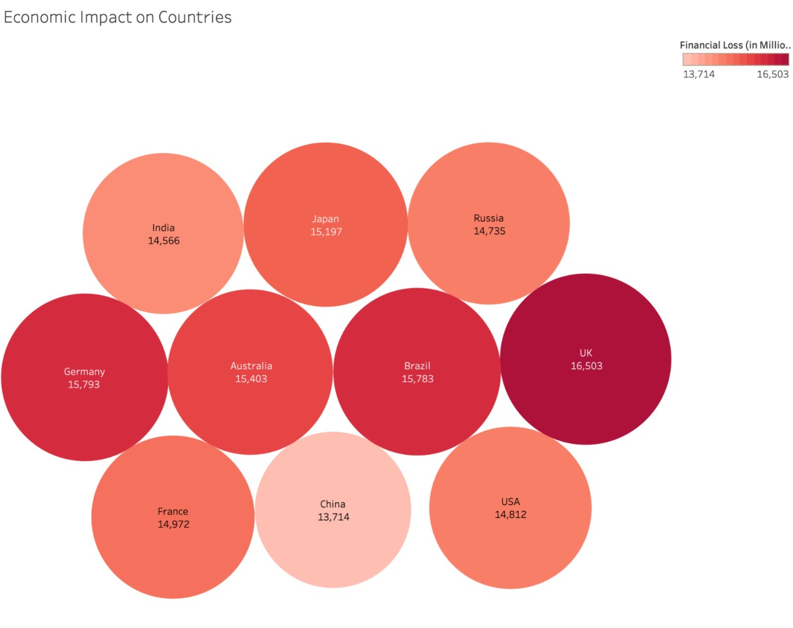
Economic Impact
Regions with advanced economies like the UK and the Germany face higher financial losses.
Estimated global losses run into billions of dollars annually, not counting underreported cases.

Slide 10
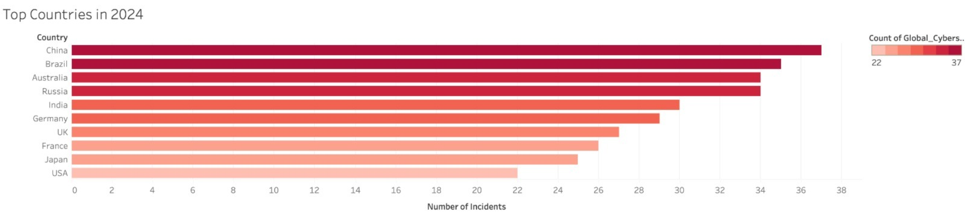
Top Countries Bar Chart
The UK records the highest number of reported cybersecurity incidents.
Factors: High digital adoption, dense financial networks, and advanced threat detection/reporting systems. The US maintains a strong position in cyber incident reports, especially in financial services, healthcare, and government sectors.
Significant investment in threat intelligence and reporting increases visibility of attacks. India shows growing numbers, possibly due to rapid digitalization and expansion of its tech ecosystem.
Germany faces consistent targeting, especially in manufacturing and critical infrastructure.

Slide 11
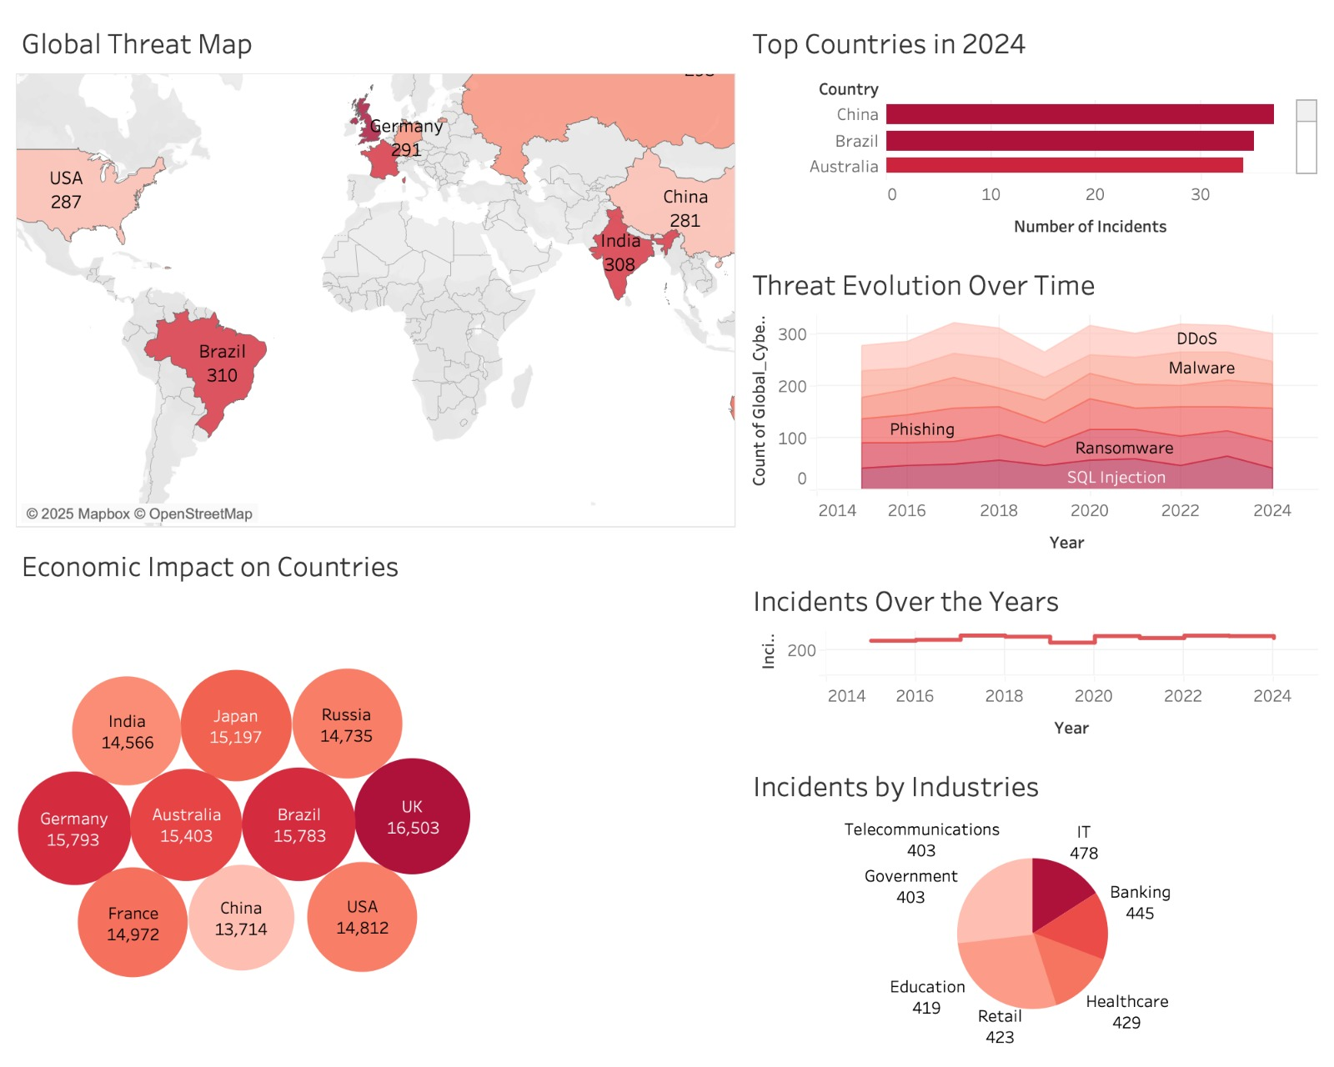
Global Cyber Security Dashboard

Slide 12
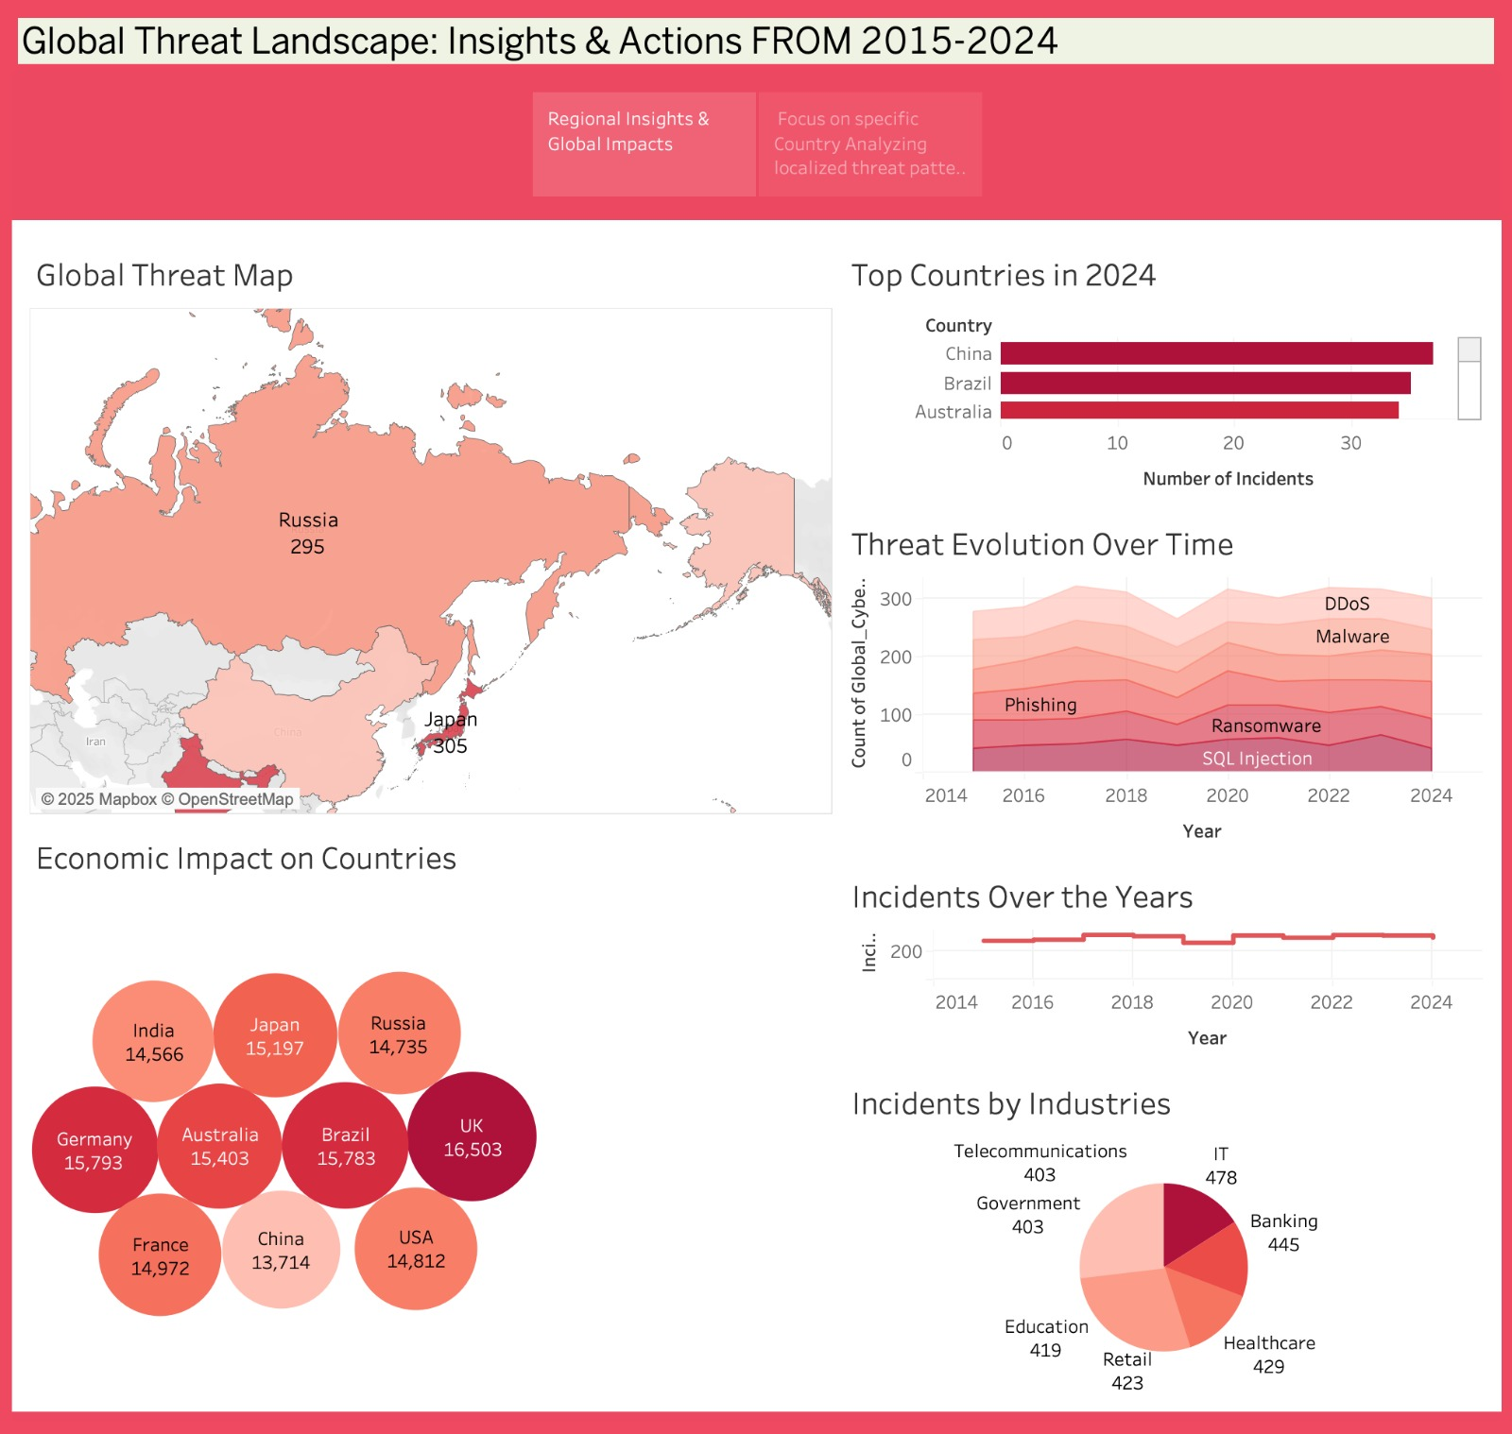
Global Cyber Security Story

Slide 13
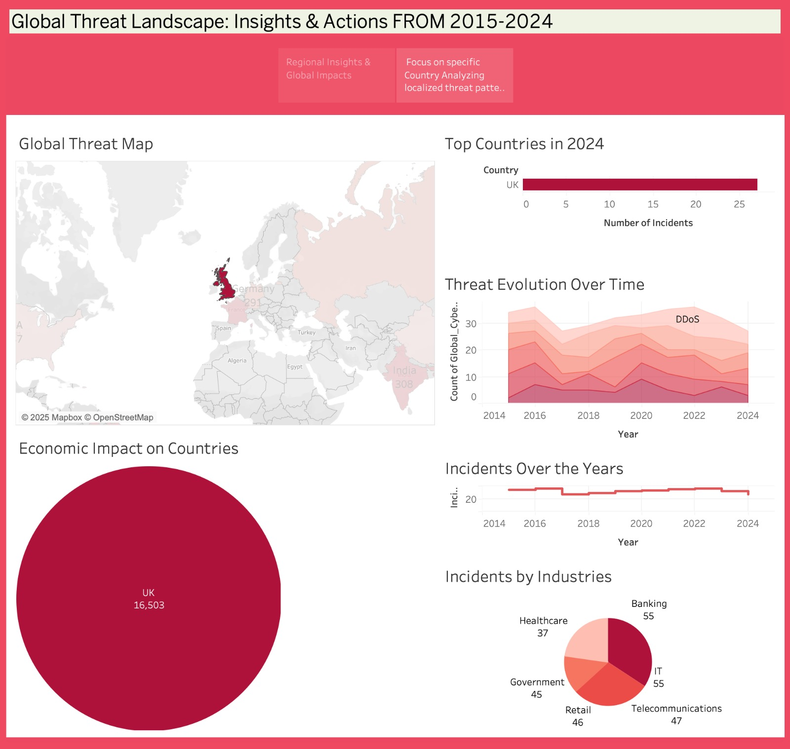
Global Threat Patterns for the country UK

Slide 14
Recommendations on the Global Cybersecurity Threats Analysis (2015–2024)
Strengthen International Collaboration.
Invest in Cybersecurity Infrastructure
Continuous Threat Monitoring & Intelligence Gathering.
Promote Cybersecurity Awareness & Training.
Encourage Proactive Regulatory Measures.
Focus on Critical Sectors Protection.
Adopt Zero Trust Security Framework

Slide 15
Conclusion
The analysis shows a clear rise in global cybersecurity threats, with the UK emerging as the most impacted country.
Cyberattacks are becoming more frequent and sophisticated, targeting critical sectors worldwide.
This highlights the urgent need for stronger security measures, global cooperation, and continuous vigilance to protect against evolving digital risks.

Slide 16

Thank you

